Slide 1
12 global politics
Week 1
Notes:
Distribute overview
Distribute exam example
Collect homework

Slide 2
LEARNING INTENTIONs
Learning Intention
To understand the notion of the state as an actor in Global Politics
Success Criteria
WWBAT identify characteristics of states etc.
WWBAT define ‘Global Governance’
WWBAT explain how states operate in global governance
WWBAT identify potential challenges that face the state system.

Slide 3
state
LEARNING INTENTIONS AND SUCCESS CRITERIA
Exam
Homework
Communication
Guardian App.
Learning intention
To understand the notion of the state as an actor in Global Politics
Success Criteria
WWBAT identify characteristics of states etc.
WWBAT define ‘Global Governance’
WWBAT explain how states operate in global governance
WWBAT identify potential challenges that face the state system.

Slide 4
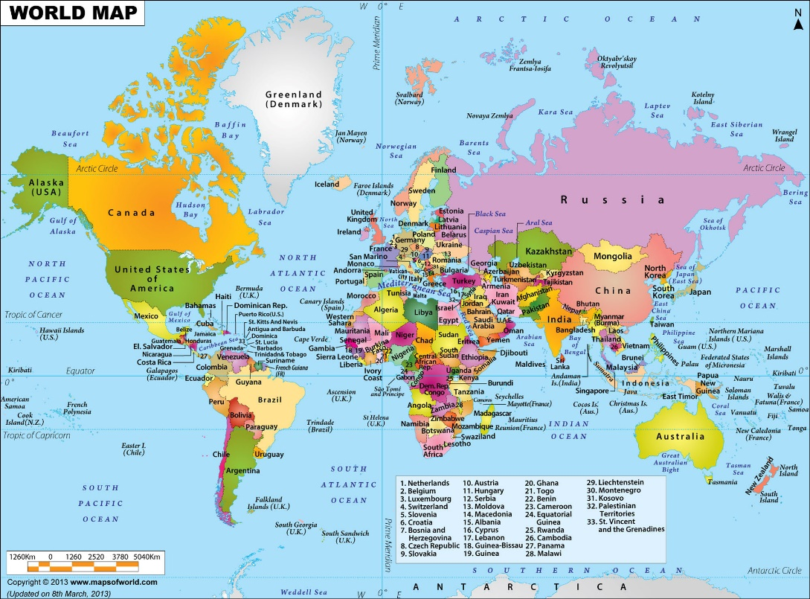
state
LEARNING INTENTIONS AND SUCCESS CRITERIA
Traditionally the central actor in international relations,
states possess a permanent population, defined territory and recognised sovereignty. States are not necessarily culturally homogenous, for example Australia.
-VCAA STUDY DESIGN
Learning intention
To understand the notion of the state as an actor in Global Politics
Success Criteria
WWBAT identify characteristics of states etc.
WWBAT define ‘Global Governance’
WWBAT explain how states operate in global governance
WWBAT identify potential challenges that face the state system.

Slide 5
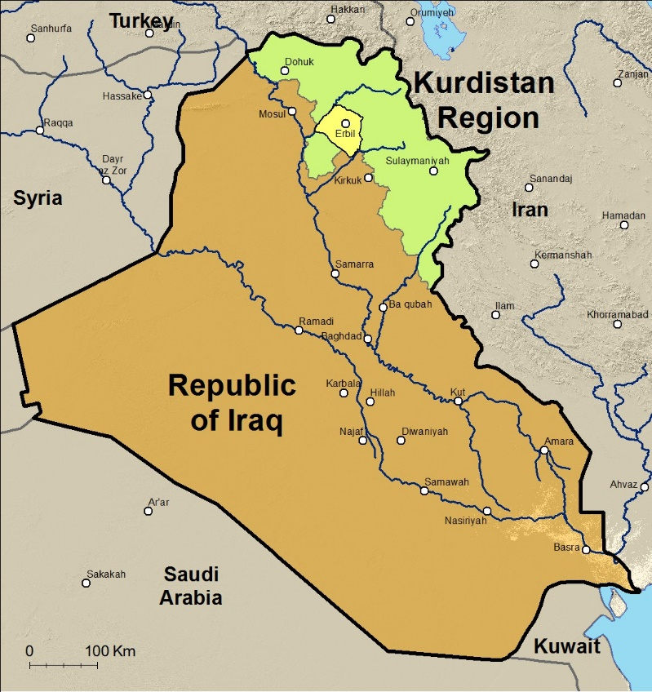
nation
LEARNING INTENTIONS AND SUCCESS CRITERIA
Groups of people claiming common bonds based on
culture, language and history. Some nations have their
own state, such as the Japanese, whilst others want their own state such as the Tibetans and Kurds.
-VCAA STUDY DESIGN
Learning intention
To understand the notion of the state as an actor in Global Politics
Success Criteria
WWBAT identify characteristics of states etc.
WWBAT define ‘Global Governance’
WWBAT explain how states operate in global governance
WWBAT identify potential challenges that face the state system.

Slide 6
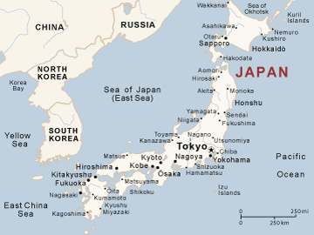
Nation-state
LEARNING INTENTIONS AND SUCCESS CRITERIA
Political social grouping in which people within territorial
boundaries, with recognised sovereignty, have common
bonds based on culture, language and history.
-VCAA STUDY DESIGN
Learning intention
To understand the notion of the state as an actor in Global Politics
Success Criteria
WWBAT identify characteristics of states etc.
WWBAT define ‘Global Governance’
WWBAT explain how states operate in global governance
WWBAT identify potential challenges that face the state system.

Slide 7
State-sovereignty
LEARNING INTENTIONS AND SUCCESS CRITERIA
Legitimate or widely recognised ability to exercise effective control of a territory within recognised borders. Primary organising principle of global politics which provides states with the authority to represent their territorial entity within the international community.
State sovereignty can be challenged internally (for example, secessionist groups) or externally (for example, one state invades another).
-VCAA STUDY DESIGN
Learning intention
To understand the notion of the state as an actor in Global Politics
Success Criteria
WWBAT identify characteristics of states etc.
WWBAT define ‘Global Governance’
WWBAT explain how states operate in global governance
WWBAT identify potential challenges that face the state system.

Slide 8
State system
LEARNING INTENTIONS AND SUCCESS CRITERIA
What might be meant by the term state-system?
Learning intention
To understand the notion of the state as an actor in Global Politics
Success Criteria
WWBAT identify characteristics of states etc.
WWBAT define ‘Global Governance’
WWBAT explain how states operate in global governance
WWBAT identify potential challenges that face the state system.

Slide 9
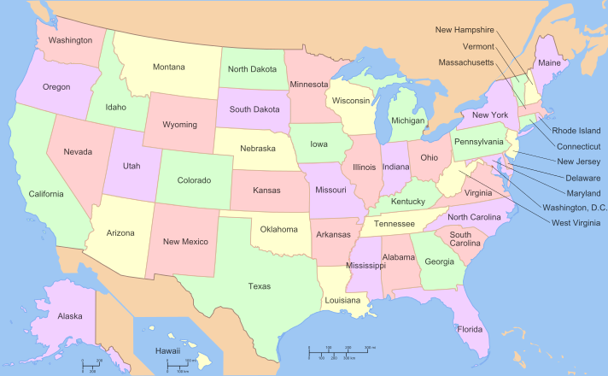
Success criteria 1
LEARNING INTENTIONS AND SUCCESS CRITERIA
Learning intention
To understand the notion of the state as an actor in Global Politics
Success Criteria
WWBAT identify characteristics of states etc.
WWBAT define ‘Global Governance’
WWBAT explain how states operate in global governance
WWBAT identify potential challenges that face the state system.
Notes:
Is this a nation, state or nation-state?

Slide 10
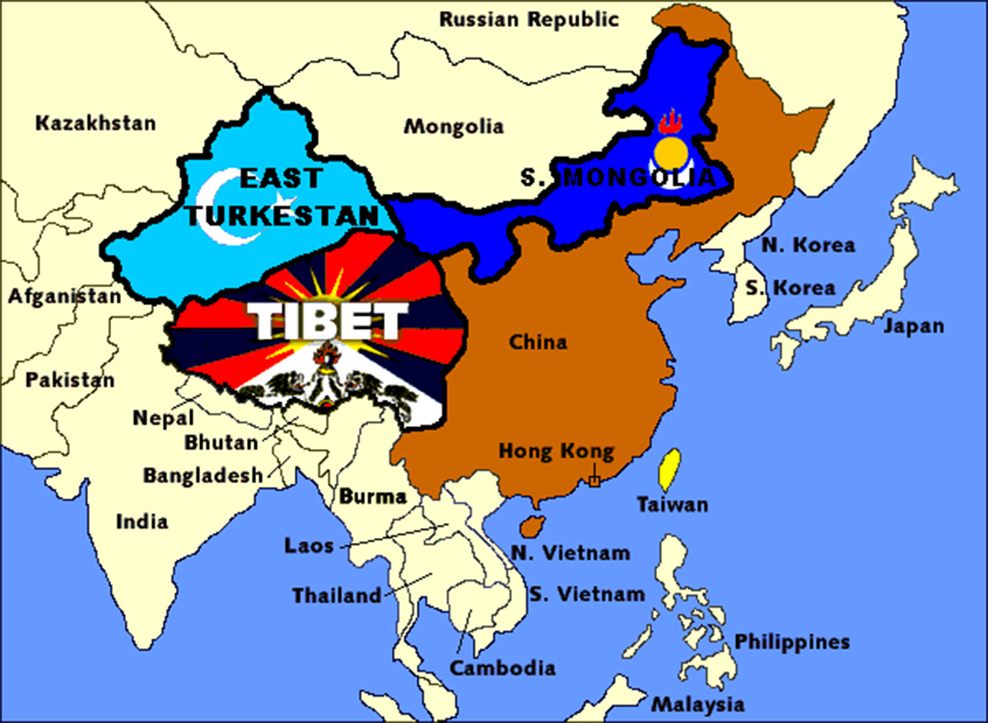
Success criteria 1
LEARNING INTENTIONS AND SUCCESS CRITERIA
Learning intention
To understand the notion of the state as an actor in Global Politics
Success Criteria
WWBAT identify characteristics of states etc.
WWBAT define ‘Global Governance’
WWBAT explain how states operate in global governance
WWBAT identify potential challenges that face the state system.
Notes:
Is this a nation, state or nation-state?

Slide 11
Global governance
LEARNING INTENTIONS AND SUCCESS CRITERIA
Institutions, rules, norms and legal arrangements that seek to facilitate cooperation, and manage relations, between states.
Governance is carried out by both governmental
organisations such as the United Nations and nongovernmental organisations such as the International Criminal Court.
-VCAA STUDY DESIGN
Learning intention
To understand the notion of the state as an actor in Global Politics
Success Criteria
WWBAT identify characteristics of states etc.
WWBAT define ‘Global Governance’
WWBAT explain how states operate in global governance
WWBAT identify potential challenges that face the state system.
Notes:
What are the different actors in Global Governance?

Slide 12
Global governance
LEARNING INTENTIONS AND SUCCESS CRITERIA
Learning intention
To understand the notion of the state as an actor in Global Politics
What are the different actors in Global Governance?
Success Criteria
WWBAT identify characteristics of states etc.
WWBAT define ‘Global Governance’
WWBAT explain how states operate in global governance
WWBAT identify potential challenges that face the state system.
Notes:
What are the different actors in Global Governance?

Slide 13
Global governance
LEARNING INTENTIONS AND SUCCESS CRITERIA
Define ‘global governance’ as it relates to the study of global politics.
Define ‘state-sovereignty’ as it relates to the study of global politics.
Define ‘global governance’ as it relates to the study of global politics.
Define ‘state’ as it relates to the study of global politics.
Learning intention
To understand the notion of the state as an actor in Global Politics
Success Criteria
WWBAT identify characteristics of states etc.
WWBAT define ‘Global Governance’
WWBAT explain how states operate in global governance
WWBAT identify potential challenges that face the state system.
Notes:
All the examiners want you to do is write out the study design definition, don’t use the term in your answer.
Non-circular definitions
The study design defines global governance as ‘Institutions, rules, norms and legal arrangements that seek to facilitate cooperation, and manage relations, between states. Governance is carried out by both governmental organisations such as the United Nations and non-governmental organisations such as the International Criminal Court.’ Students were not required to include an example. Students are to be discouraged from writing ‘circular definitions’, where the word being defined is used within the definition.

